Slide 1

Selections
TUIT
C++ Programming, Fall 2016
Lecture #3
II – part

Slide 2
TUIT
Roadmap
Last week we covered
Elementary Programming
This week we will learn
Case Study: Computing Body Mass Index
Case Study: Computing Taxes
Generating Random Numbers
Logical Operators
Case Study: Determining Leap Year
Case Study: Lottery
switch Statements
Conditional Expressions
Operator Precedence and Associativity
Debugging

Slide 3
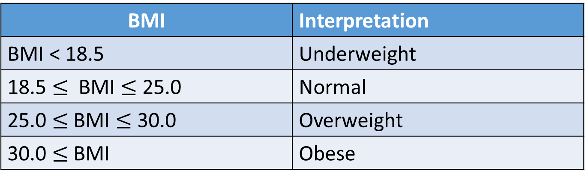
TUIT
Case Study: Computing Body Mass Index
You can use nested if statements to write a program that interprets Body Mass Index. Body Mass Index (BMI) is a measure of health based on height and weight. You can calculate your BMI by taking your weight in kilograms and dividing it by the square of your height in meters. The interpretation of BMI for people 20 years or older is as follows:
BMI | Interpretation
BMI < 18.5 | Underweight
18.5 $≤$ BMI $≤$ 25.0 | Normal
25.0 $≤$ BMI $≤$ 30.0 | Overweight
30.0 $≤$ BMI | Obese
1 inch = 0.0254 meter, 1 pound = 0.45359237 kilogram

Slide 4
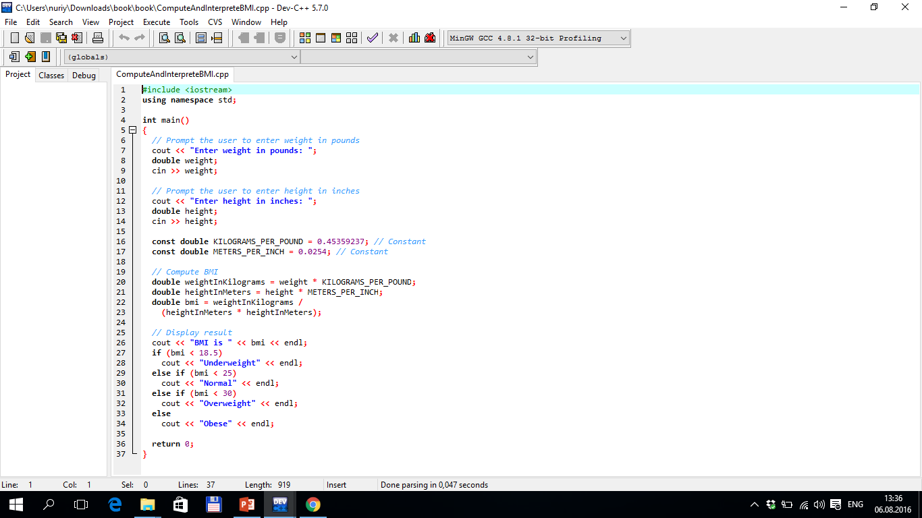


TUIT
Computing Body Mass Index
Enter weight in pounds: 146 Enter height in inches: 70 BMI is 20.9486 Normal

Slide 5
TUIT
Case Study: Computing Taxes
You can use nested if statements to write a program for computing taxes. The US federal personal income tax is calculated based on filing status and taxable income.
Marginal Tax Rate | Single | Married Filing Jointly or Qualifying Window(er) | Married Filing Separately | Head of Household
10% | $0 - $8,350 | $0 - $16,700 | $0 – $8,350 | $0 - $11,950
15% | $8,351 - $33,950 | $16,701 - $67,900 | $8,351 - $33,950 | $11,951 - $45,500
25% | $33,951 - $82,250 | $67,901 - $137050 | $33,951 - $68,525 | $45,501 - $117,450
28% | $82,251 - $171,550 | $137051 - $208,850 | $68,526 - $104,425 | $117,451 - $190,200
33% | $171,551 - $372, 950 | $208,851 - $372,950 | $104,426 - $186,475 | $190,201 - $372,950
35% | $372,951 + | $372,951 + | $186,476 + | $372,951 +

Slide 6
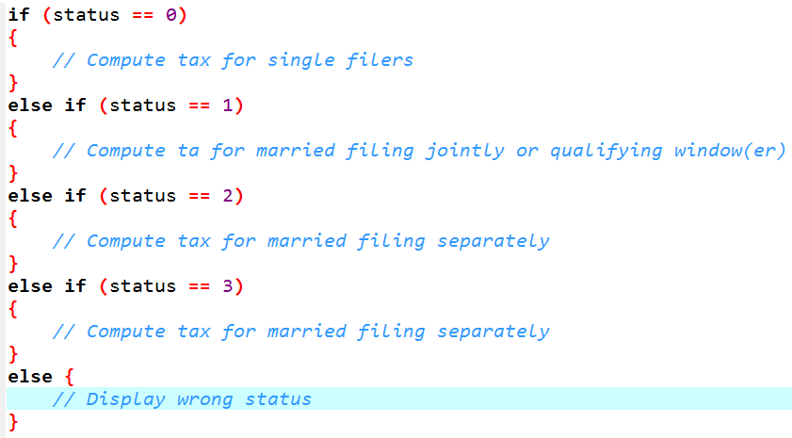
TUIT
Case Study: Computing Taxes

Slide 7
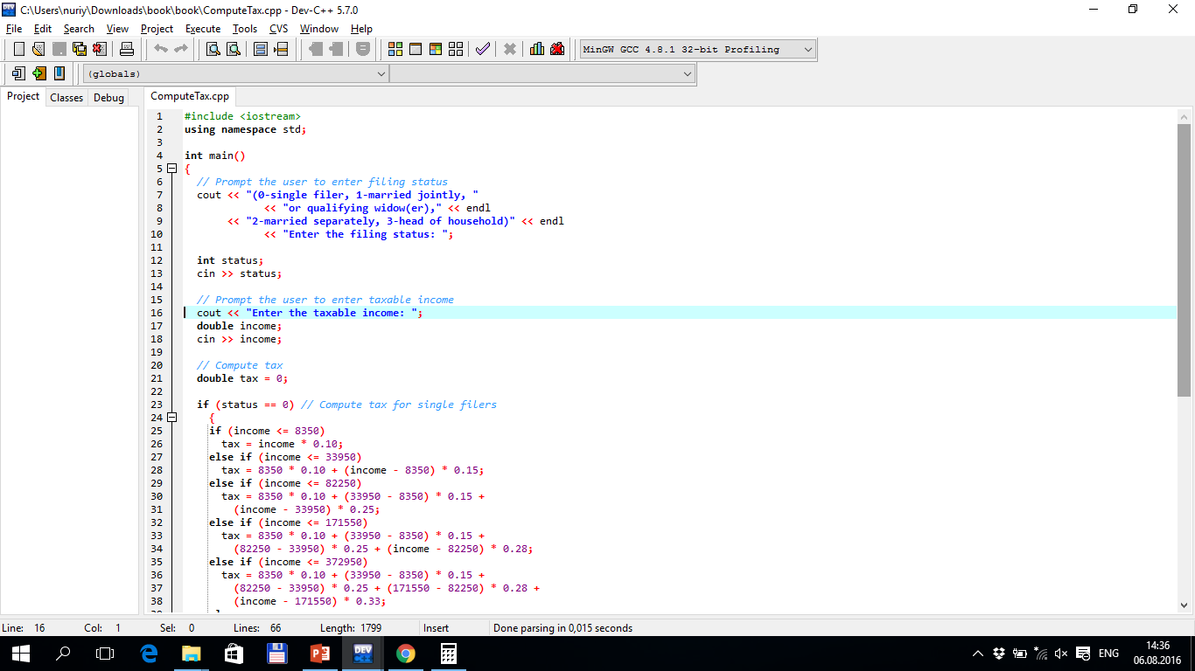
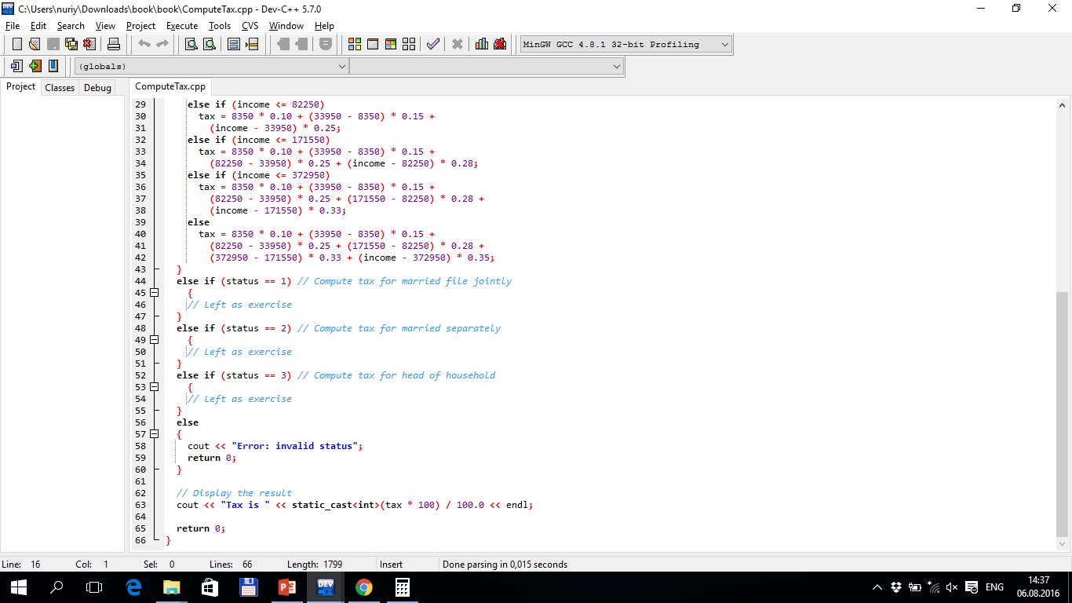
TUIT
Case Study: Computing Taxes

Slide 8
TUIT
Case Study: Computing Taxes
(0 – single filer, 1 – married jointly or qualifying window(er), 2 – married separately, 3 – head of household) Enter the filing status: 0 Enter the taxable income: 400000 Tax is 117684

Slide 9
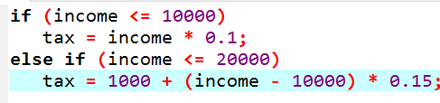
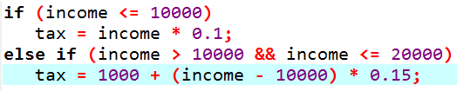
TUIT
Check Point
Are the following statements equivalent?

Slide 10
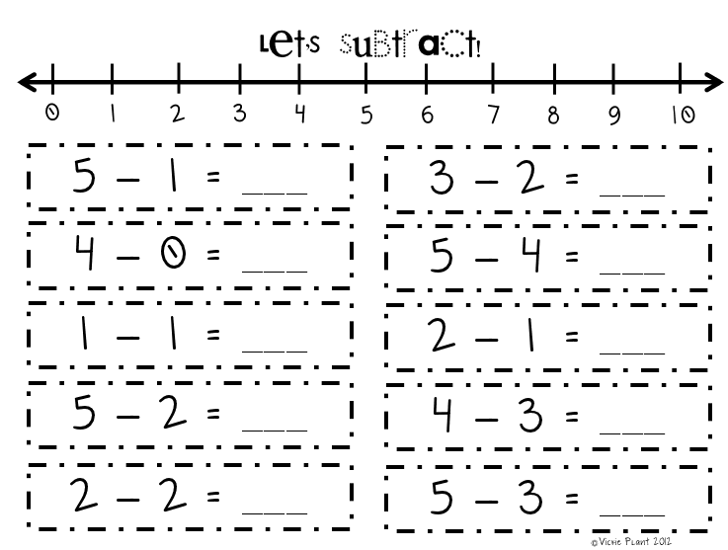
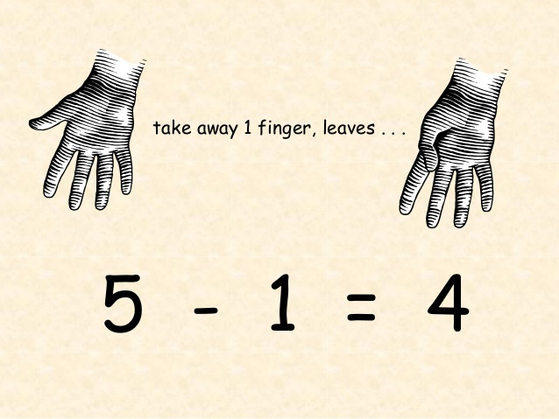
TUIT
Generating Random Numbers
You can use the rand() function to obtain a random integer. Suppose you want to develop a program for a first – grader to practice subtraction.

Slide 11
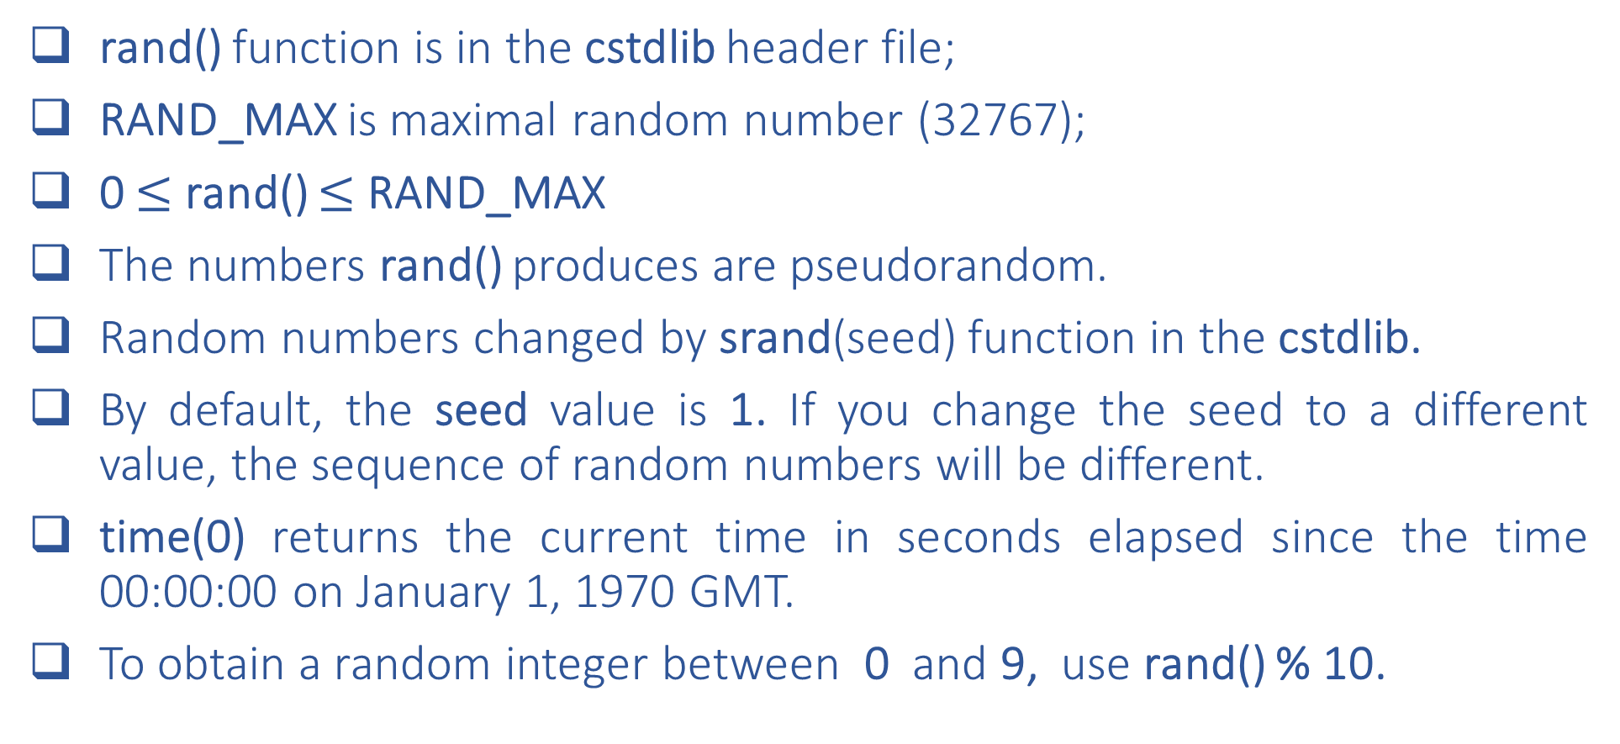
TUIT
Generating Random Numbers
rand() function is in the cstdlib header file;
RAND_MAX is maximal random number (32767);
0 $≤$rand() $≤$ RAND_MAX
The numbers rand() produces are pseudorandom.
Random numbers changed by srand(seed) function in the cstdlib.
By default, the seed value is 1. If you change the seed to a different value, the sequence of random numbers will be different.
time(0) returns the current time in seconds elapsed since the time 00:00:00 on January 1, 1970 GMT.
To obtain a random integer between 0 and 9, use rand() % 10.

Slide 12
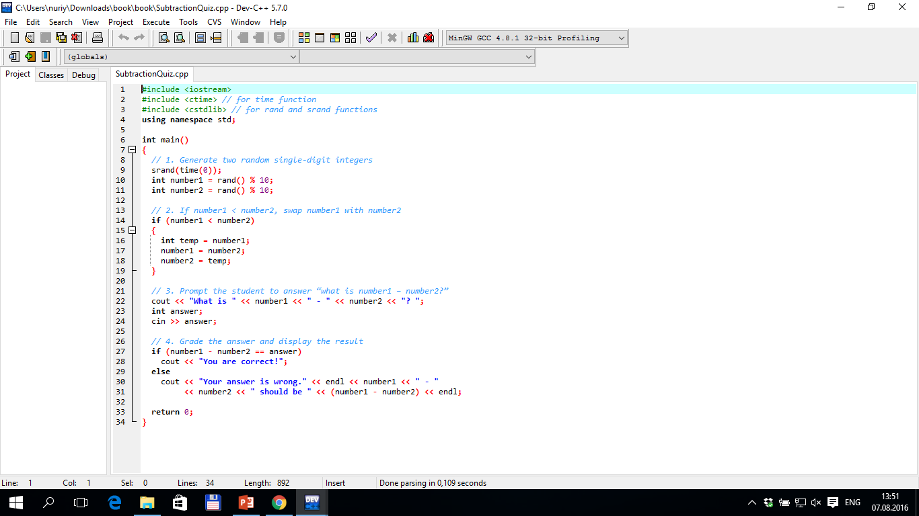
TUIT
SubtractionQuiz.cpp
What is 5 – 2? 3 You are correct!
What is 4 – 2? 1 You answer is wrong. 4 – 2 should be 2

Slide 13
TUIT
Check Point
1. How do you generate a random integer i such that $0≤i≤20$?
2. How do you generate a random integer i such that $10≤i≤20$?

Slide 14
TUIT
Logical Operators
The logical operators !, &&, and || can be used to create a compound Boolean expression.
Boolean Operators
operator | name | descriptor
! | not | logical negation
&& | and | logical conjunction
|| | or | logical disjunction

Slide 15
TUIT
Boolean Operators
Truth Table for Operator !
p | !p | Example (assume age = 24, weight = 140)
true | false | !(age > 18) is false, because (age > 18) is true.
false | true | !(weight == 150) is true, because (weight == 150) is false
Truth Table for Operator &&
p1 | p2 | p1&&p2 | Example (assume age = 24, weight = 140)
false | false | false | (age > 18) && (weight <=140) is true, because (age > 18) and (weight <=140) are both true. (age > 18) and (weight > 140) is false, because (weight > 140) is false.
false | true | false
true | false | false
true | true | true
Truth Table for Operator ||
p1 | P2 | p1||p2 | Example (assume age = 24, weight = 140)
false | false | false | (age > 34) || (weight <= 140) is true, because (weight <= 140) is true (age > 34) || (weight >= 150) is false, because (age > 34) and (weight >= 150) are both false
false | true | true
true | false | true
true | true | true

Slide 16
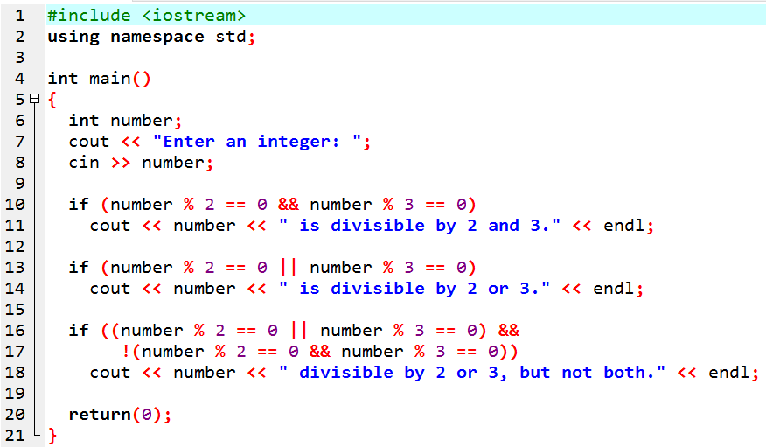
TUIT
Boolean Operators
Enter an integer: 4 4 is divisible by 2 or 3. 4 is divisible by 2 or 3, but not both.
Enter an integer: 18 18 is divisible by 2 and 3. 18 is divisible by 2 or 3.

Slide 17
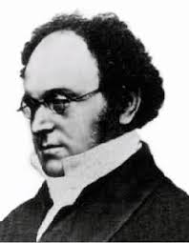
TUIT
Note
De Morgan’s law.
!(condition1 && condition2) is the same as !condition1 || !condition2
!(condition1 || condition2) is the same as !condition1 && !condition2
Augustus De Morgan
(1806 - 1871)
Example
!(number % 2 == 0 && number % 3 == 0)
(number % 2 != 0 || number % 3 != 0)

Slide 18
TUIT
Check Point
Assuming that x is 1, show the result of the following Boolean expressions:
(true) && (3 > 4)
!(x > 0) && (x > 0)
(x > 0) || (x < 0)
(x != 0) || (x == 0)
(x >= 0) || (x < 0)
(x != 1) == (x == 1)

Slide 19
TUIT
Check Point
(a)Write a Boolean expression for |x – 5| < 4.5
(b)Write a Boolean expression for |x – 5| > 4.5

Slide 20
TUIT
Check Point
To test whether x is between 10 and 100, which of the following expressions are correct?
100 > x > 10
(100 > x) && (x > 10)
(100 > x) || (x > 10)
(100 > x) and (x > 10)
(100 > x) or (x > 10)

Slide 21
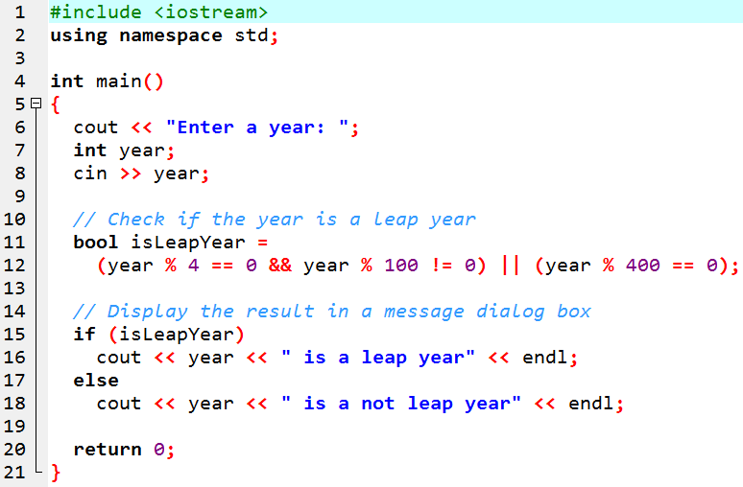
TUIT
Case Study: Determining Leap Year
A year is a leap year if it is divisible by 4 but not by 100, or if it is divisible by 400.
Enter a leap year: 2008 2008 is a leap year
Enter a year: 1900 1900 is not a leap year
Enter a year: 2002 2002 is not a leap year

Slide 22
TUIT
Case Study: Lottery
The lottery program involves generating random numbers, comparing digits, and using Boolean operators. The program randomly generates a lottery of a two – digit number, prompts the user to enter a two – digit number, and determines whether the user wins according to the following rule:
If the user input matches the lottery number in the exact order, the award is $10 000.
If all the digits in the user input match all the digits in the lottery number, the award is $3 000.
If one digit in the user input matches a digit in the lottery number, the award is $1 000.

Slide 23
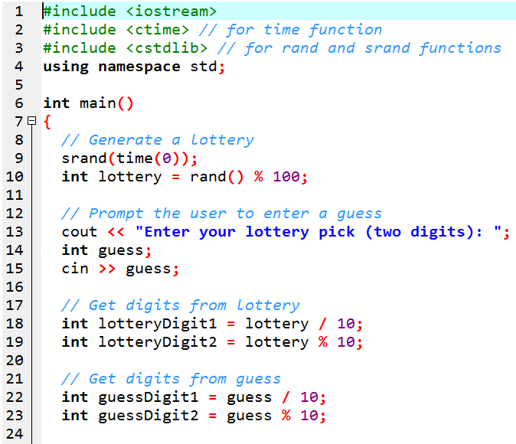
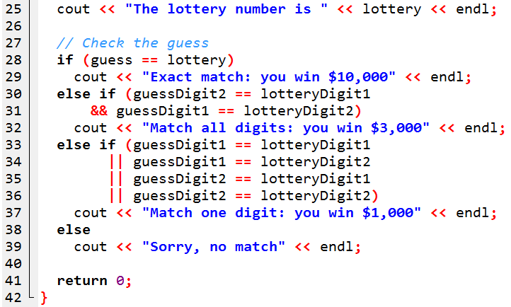
TUIT
Case Study: Lottery
Enter your lottery pick (two digits): 00 The lottery number is 0 Exact match: you win $10,000
Enter your lottery pick (two digits): 23 The lottery number is 14 Sorry, no match

Slide 24
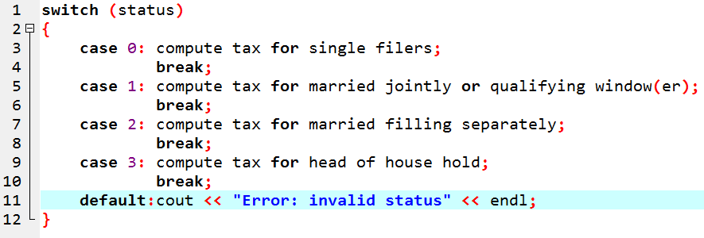
TUIT
Switch Statements
A switch statement executes statements based on the value of a variable or an expression.

Slide 25
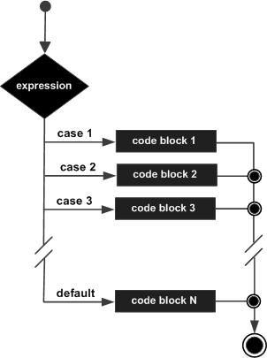
TUIT
Switch Statements

Slide 26
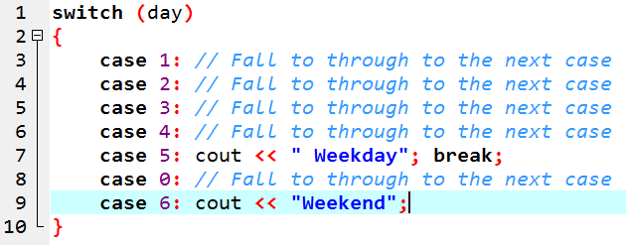
TUIT
Note
Do not forget to use a break statement when necessary. For example, the following code displays Weekdays for days 1 to 5 and Weekends for 0 and 6.

Slide 27
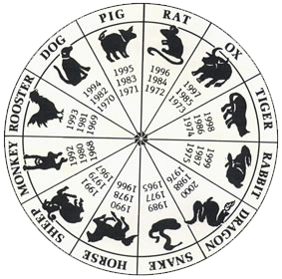
TUIT
Chinese Zodiac
0: monkey
1: rooster
2: dog
3: pig
4: rat
5: ox
6: tiger
7: rabbit
8: dragon
9: snake
10:horse
11:sheep
year % 12 =

Slide 28
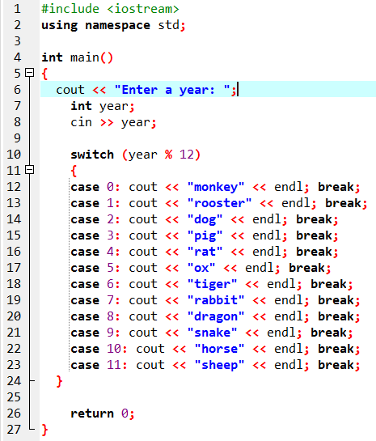
TUIT
Chinese Zodiac
Enter a year: 1963 rabbit
Enter a year: 1877 ox

Slide 29
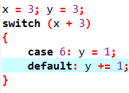
TUIT
Check Point
What is y after the following switch statement is executed? Rewrite the code using an if statement.

Slide 30
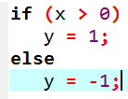
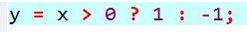
TUIT
Conditional Expressions
A conditional expression evaluates an expression based on a condition.
boolean-expression ? expression1 : expression2;
max = num1 > num2 ? num1 : num2;
cout << (num % 2 == 0 ? “num is even” : “num is odd”) << endl;

Slide 31
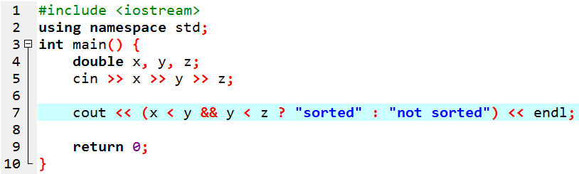
TUIT
Check Point
Suppose that, when you run the following program, you enter the input 2 3 6 from the console. What is the output?

Slide 32
TUIT
Check Point
Rewrite the following if statements using the conditional operator:
if (ages >= 16)
ticketPrice = 20;
else
ticketPrice = 10;
if (count % 10 == 0)
cout << count << endl;
else
cout << count << “ “;

Slide 33
TUIT
Operator Precedence and Associativity
Operator precedence and associativity determine the order in which operators are evaluated.
Precedence | Operator
 | var++ and var-- (Postfix)
 | +, - (Unary plus and minus), ++var and --var (Prefix)
 | static_cast<type>(v), (type) (Casting)
 | !(Not)
 | *, /, % (Multiplication, division, and remainder)
 | +, - (Binary addition and subtraction)
 | <, <=, >, >= (Relational)
 | ==, != (Equality)
 | && (AND)
 | || (OR)
 | =, +=, -=, *=, /=, %= (Assignment operator)

Slide 34
TUIT
Check Point
List the precedence order of the Boolean operators. Evaluate the following expressions:
true || true && false
true && true || false
Evaluate the following expressions:
2 * 2 – 3 > 2 && 4 – 2 > 5
2 * 2 – 3 > 2 || 4 – 2 > 5

Slide 35
TUIT
Debugging
Debugging is the process of finding and fixing errors in a program.
Syntax errors are easy to find and easy to correct because the compiler indicates where the errors came from and why they are wrong.
Runtime errors are not difficult to find either, since the operating system displays them on the console when the program aborts.
Finding logic errors, on the other hand, can be very challenging.

Slide 36
TUIT
Summary
A bool type variable can store a true or false value
The relational operators (<, <=, ==, !=, >, >=) yield a Boolean value.
Selection statements are used for programming with alternative courses of actions. There are several types of selection statements: if statements, two – way if – else statements, nested if statements, multi – way if – else statements, switch statements, and conditional expressions.
The Boolean operators &&, ||, and ! operate with Boolean values and variables.
Operators with higher precedence are evaluated earlier. For operators of the same precedence, their associativity determines the order of evaluation.

